Slide 1
Presentation Skills
Keeping it simple

Slide 2
Susan McConnell (Stanford): Designing effective scientific presentations
https://www.youtube.com/watch?v=Hp7Id3Yb9XQ&t=239s

Slide 3
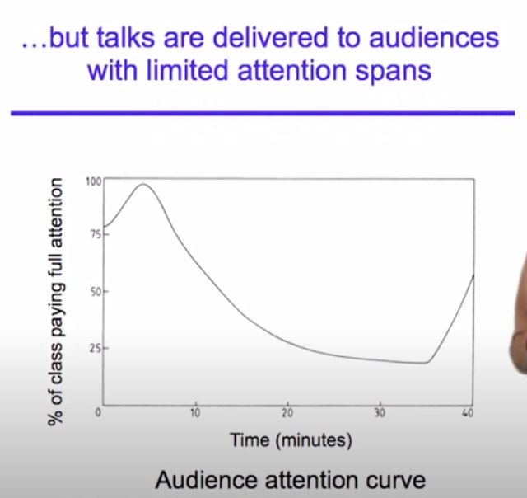

Slide 4
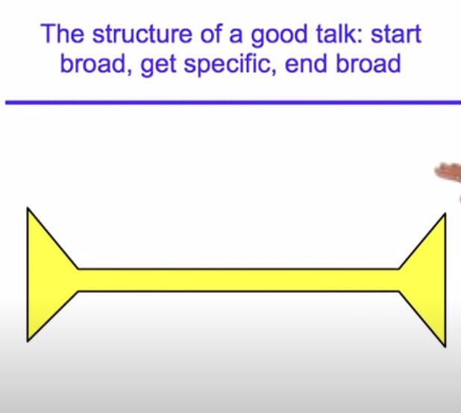

Slide 5
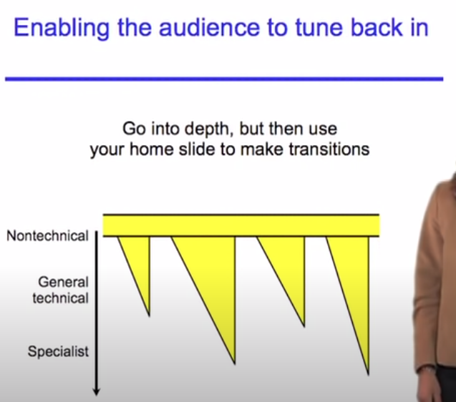

Slide 6
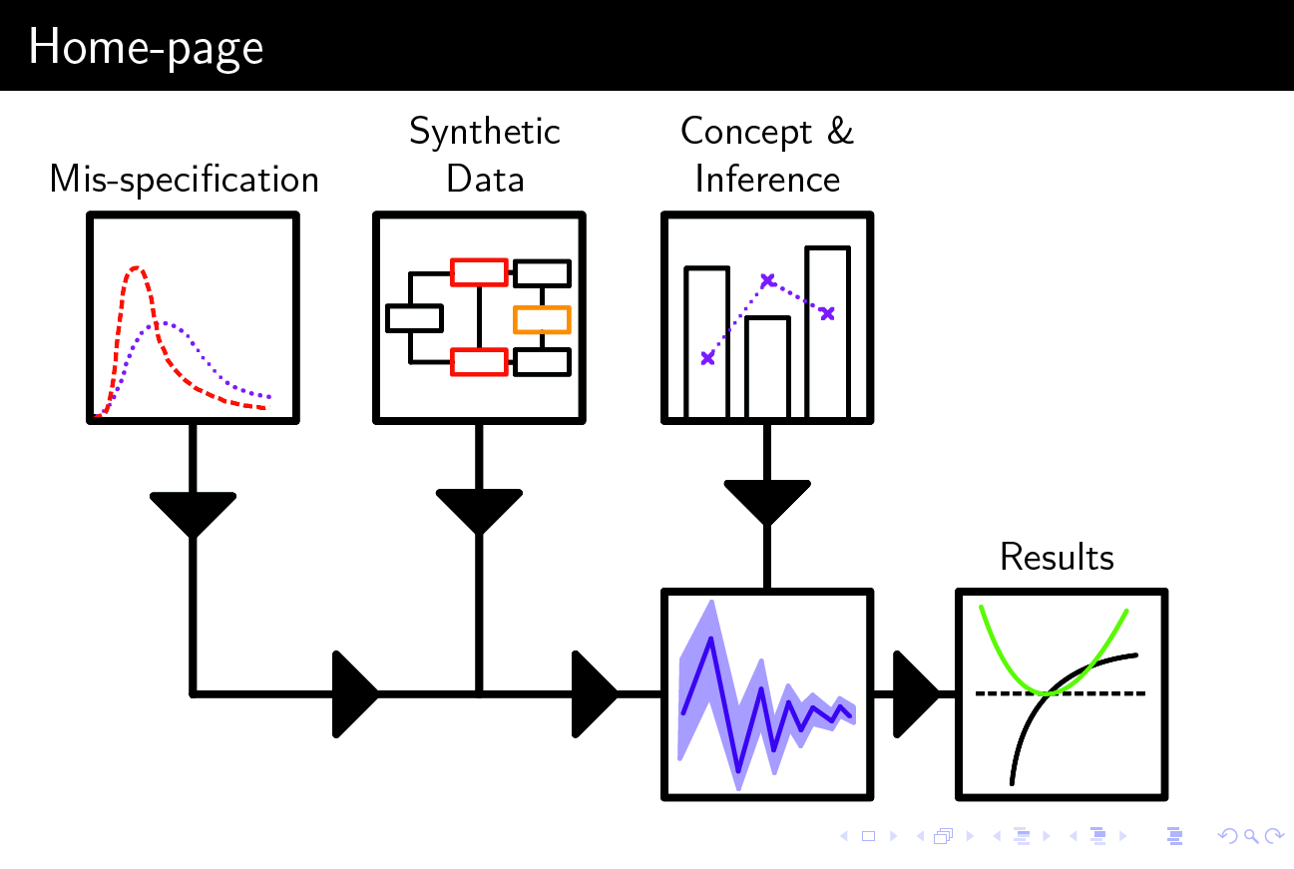

Slide 7
General advice
Time-management
Structuring the talk: telling a story?
?

Slide 8
Slide Design
Text
Figures
Colours
Keeping the audience engaged
?

Slide 9
Verbal/Public speaking skills
Speaking tips
Stage fright
?

